Slide 1
HR Dataset Analysis
Michael Czuba

Slide 2
ABOUT The Data
The data set is a public HR dataset last updated October 2020 and tracks some standard HR employment metrics.
The dataset explored 311 employees across 36 variables.
The only NA information present were in variables where it would be expected

Slide 3
Data Cleansing
Created
1 Data Inconsistency
4 New Variables
PerformanceID and Performance Score
3 Date Derived
Years of Service, Years since Last Review, Age
1 Calcualted
Cost of Absence

Slide 4
To Reduce Labor Costs:
Where is Turnover Occurring and what is its impact?
Where are Absences occurring and what is its impact?
Is there evidence of gender-based discrimination or mistreatment?
What strategies can be put into place to reduce or delay termination?

Slide 5

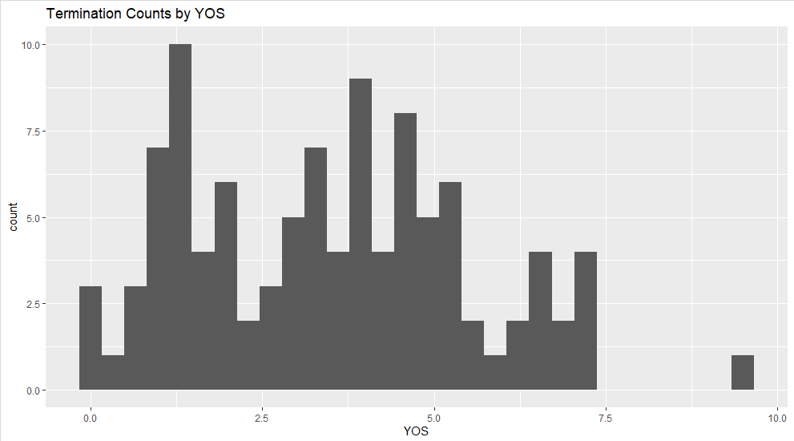
Where is Turnover Occurring and what is its impact?
33% turnover
Burnout and absenteeism among those who stay

Slide 6
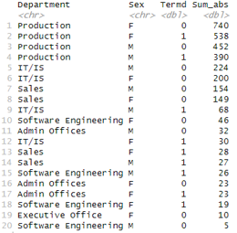
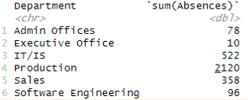
Where are Absences occurring and what is its impact?
By Department
By department, Sex, Termination Status

Slide 7
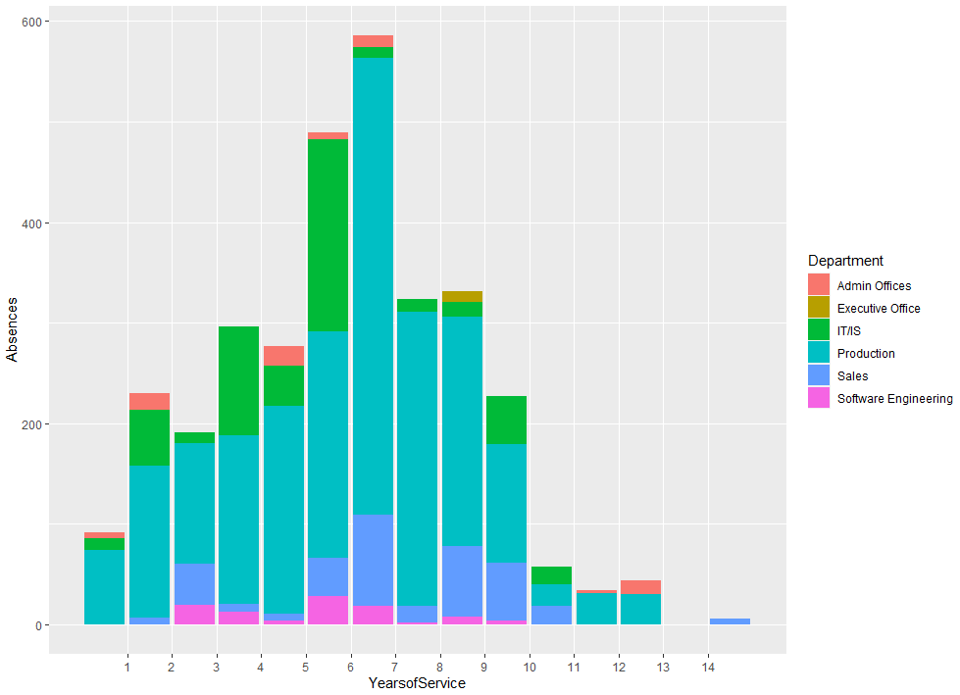

Slide 8
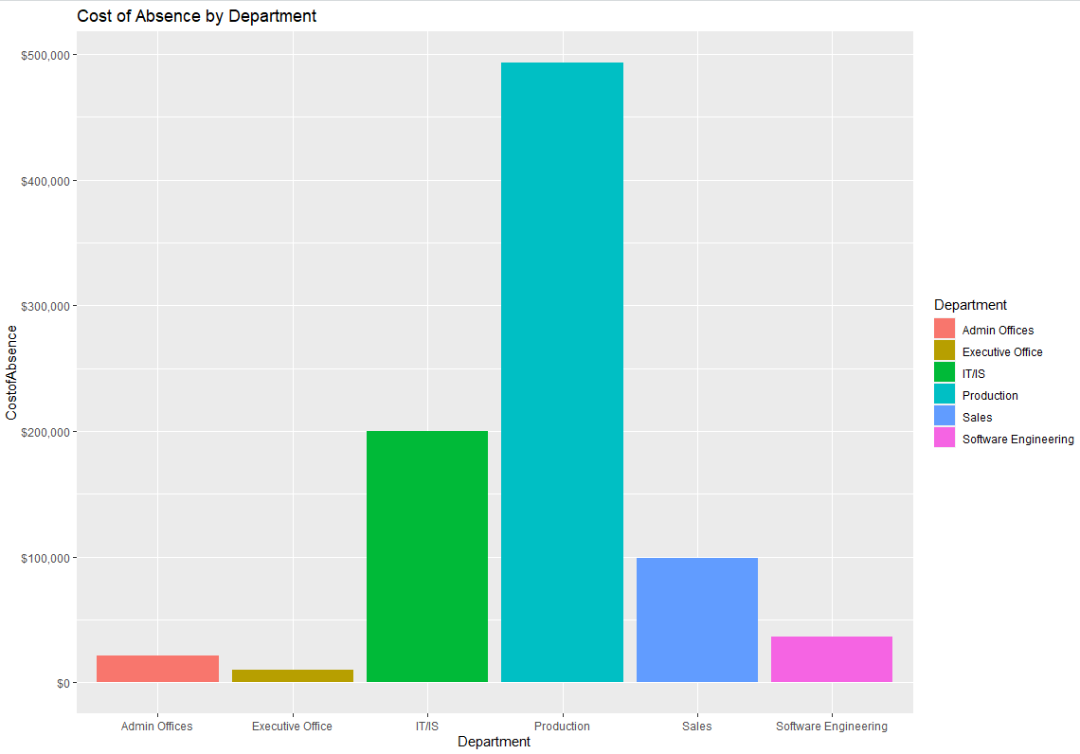

Slide 9
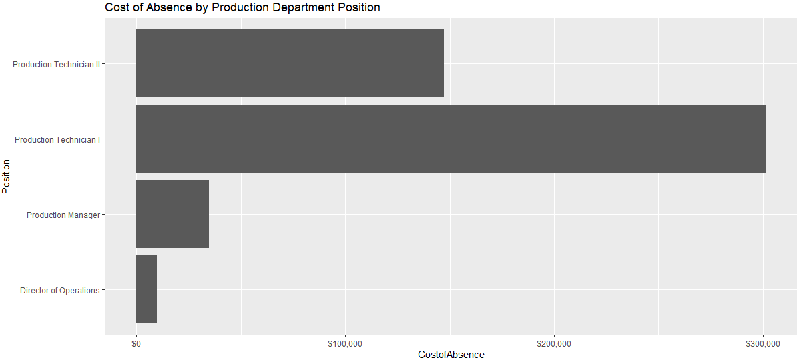
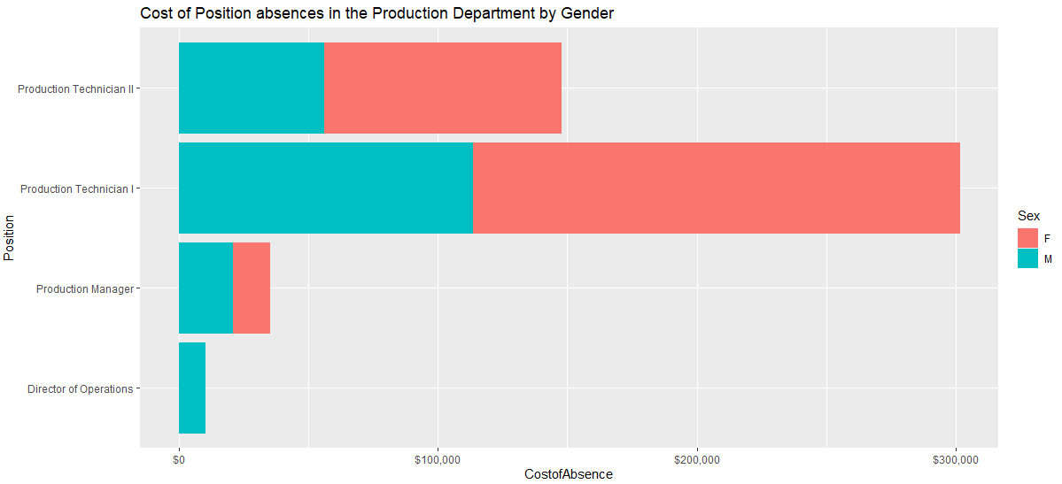

Slide 10
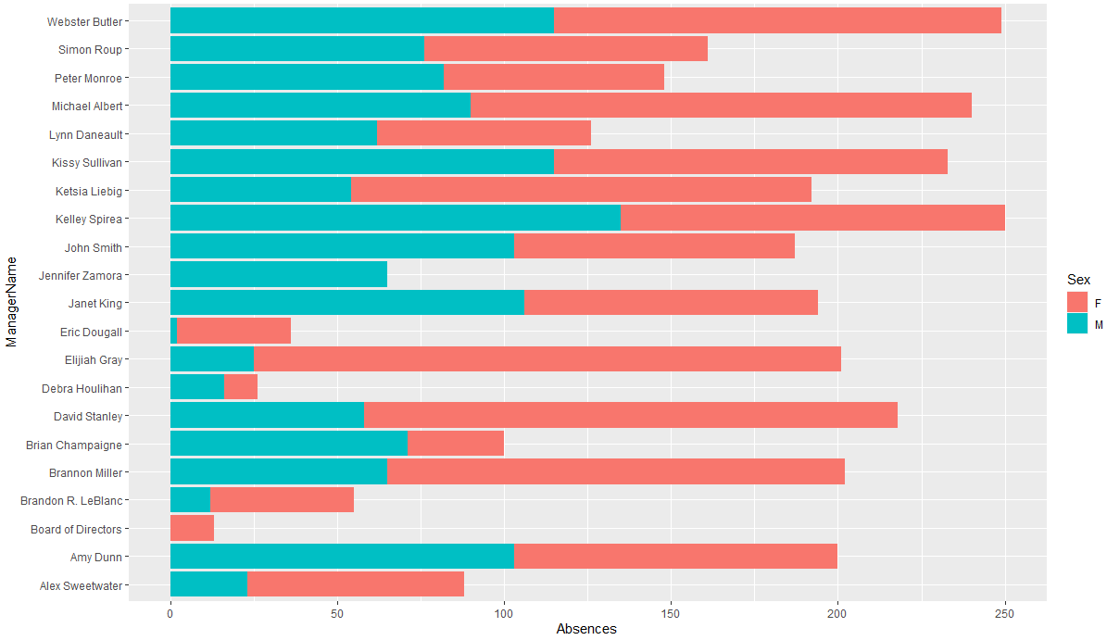
Is there evident of gender-based discrimination or mistreatment?
Assumed gender of manager had frequent majority absences by other gender

Slide 11



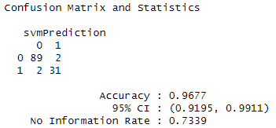
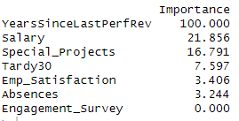
SVM
Variables Used
Predicting
Results
Salary
Engagement Survey Score
Employee Satisfaction Score
Special Projects Count
Years since Last Performance Review
Absences
Days Late last 30 days
Termination

Slide 12
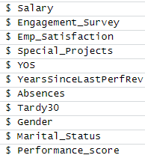
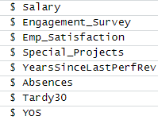

LM Model = YOS~
LM1
Lm2
LM3
Special_projects***
YearsSinceLastPerfRev***
Adj r-squared: .5831
Special_projects***
YearsSinceLastPerfRev***
Adj r-squared: .5857
Special_projects***
YearsSinceLastPerfRev***
Adj r-squared: .5867

Slide 13
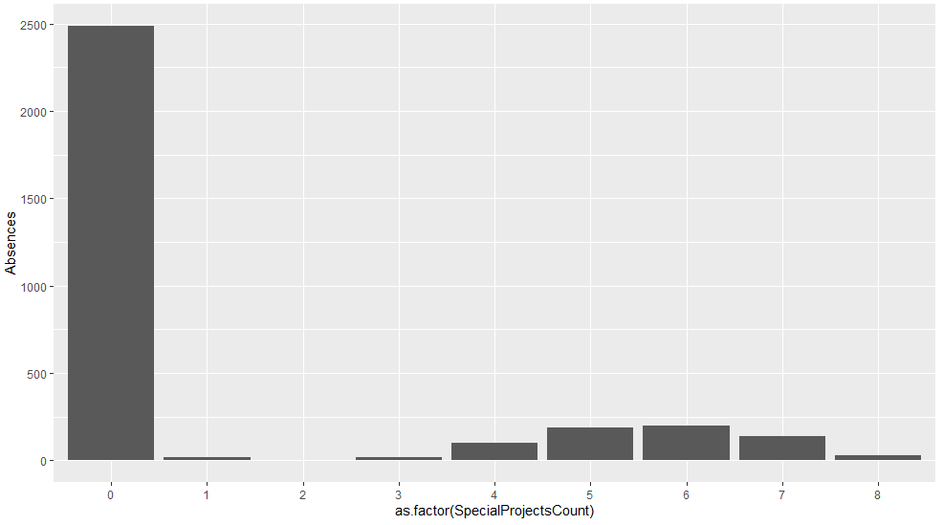
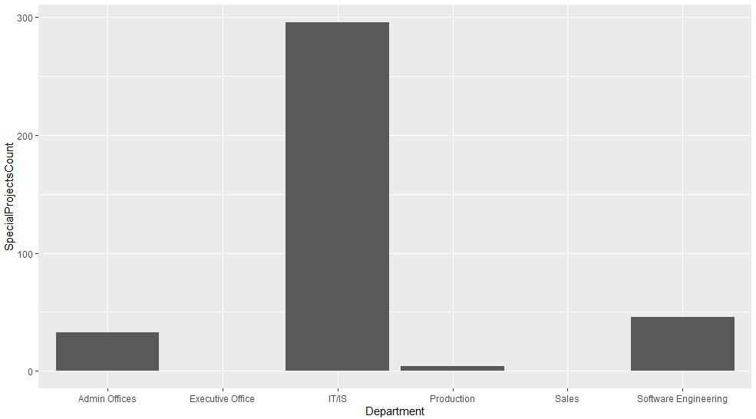
Implemented Strategies to Combat Turnover and Absenteeism
Increase the number of special projects available
Sharp Decline in absenteeism when assigned projects, which have been largely siloed to IT
Production is 4x larger than IT, IT has 1/8th the turnover.

Slide 14
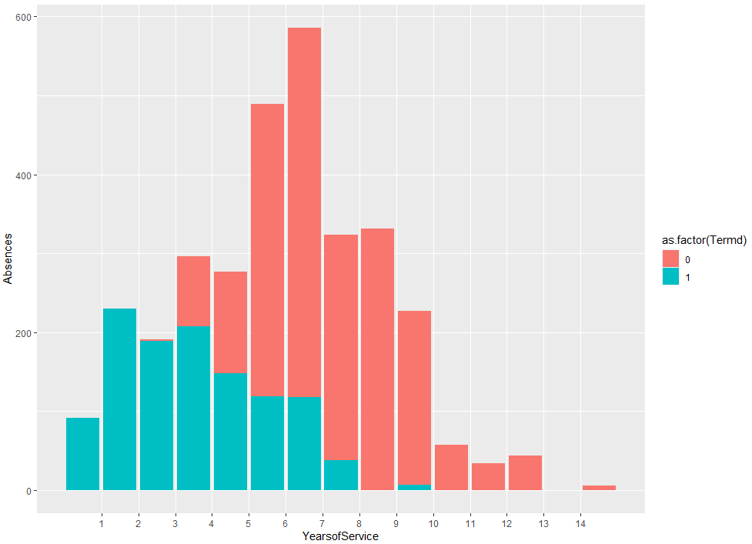
Implemented Strategies to Combat Turnover and Absenteeism
Absenteeism is high at the 6 year mark because all the termination in the first 3 years
Suggests compounding issue
Increase the frequency of the review process
Median Years since last Performance Review was 1.78 years

Slide 15
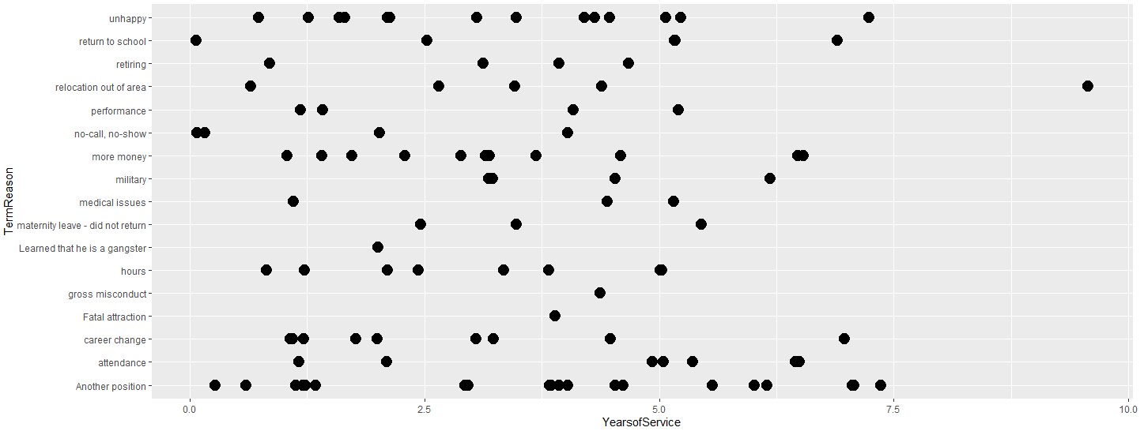
By Increasing the frequency of reviews and special projects, we are increasing the amount of career development earlier on in the employee life cycle.

Slide 16
THANK YOU

